Slide 1



welcome to
AI-Based Automated Presentation Generator
Creating complete, professional presentations using artificial intelligence.
Presented By:
Amritpal Singh

Slide 2


The Challenge of Modern Presentations
Time-Intensive Process
Design Expertise Required
Students and professionals invest countless hours crafting presentations from scratch, often working late into the night.
Creating visually appealing slides demands design skills that many users simply don't possess.
Content Quality Concerns
Maintaining consistency in formatting, tone, and structure across multiple slides is challenging without the right tools.

Slide 3
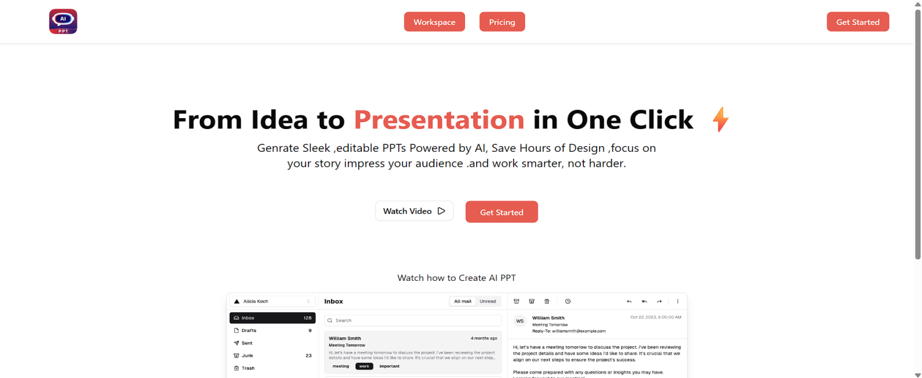
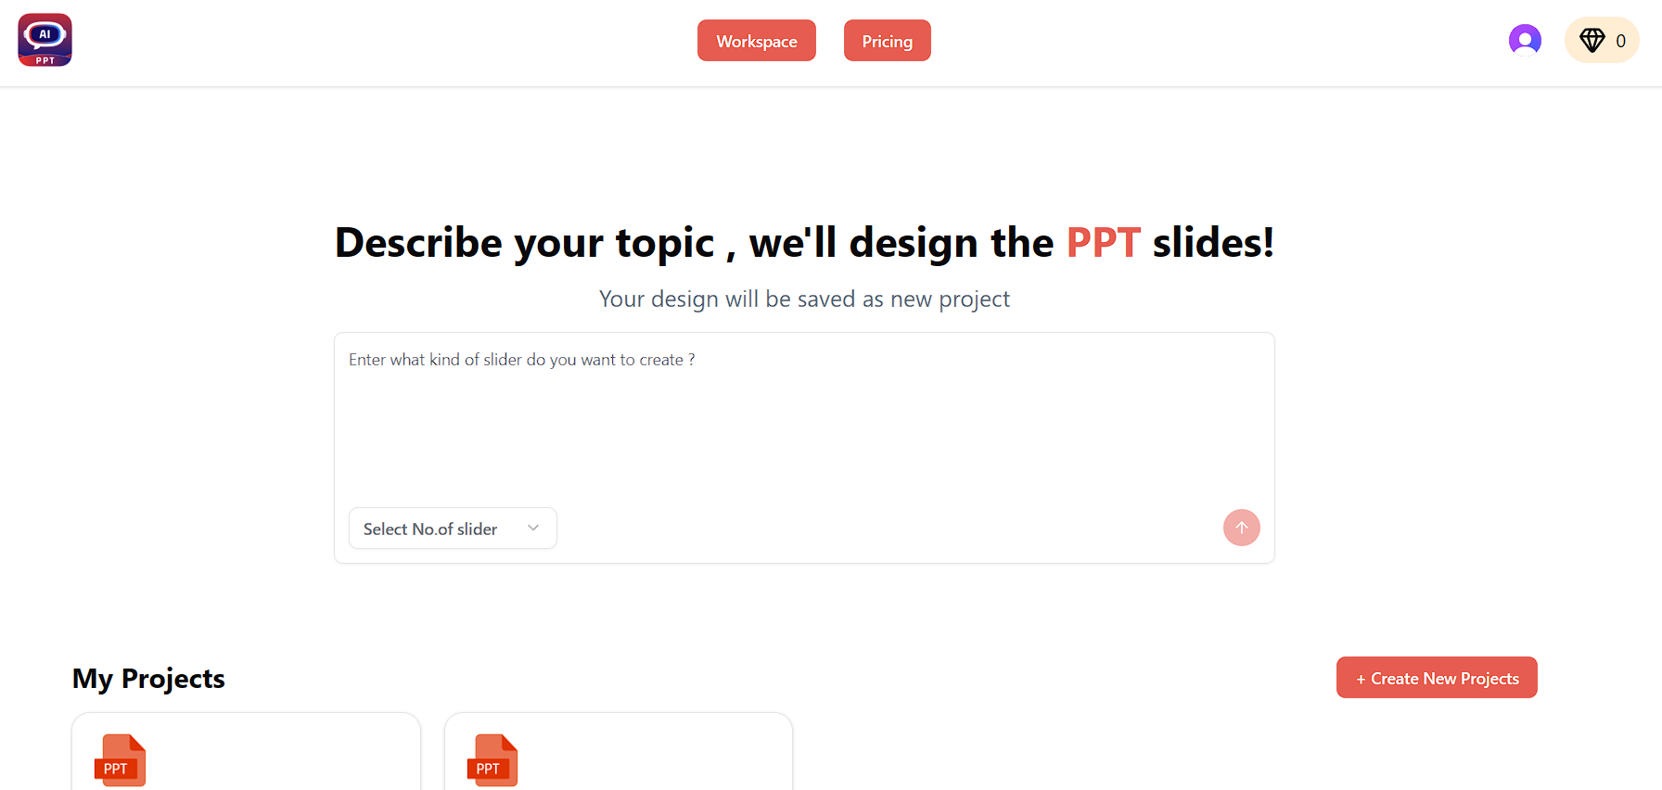
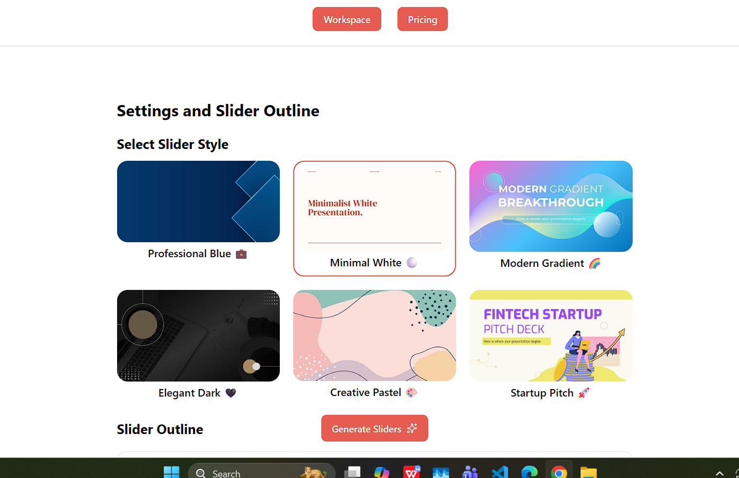
Our Solution: Intelligent Automation
What We Built
A comprehensive web application that transforms a simple topic into a complete, professional presentation—automatically generating outlines, slide content, and stunning visuals powered by AI.
The platform combines cutting-edge AI with intuitive editing tools, enabling users to create presentation-ready decks in minutes instead of hours.

Slide 4

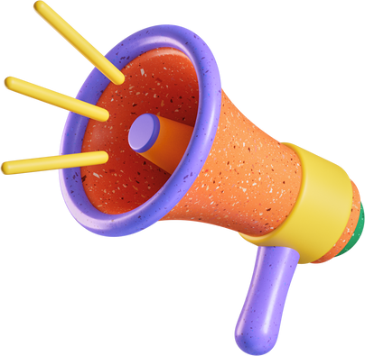
Core Features & Capabilities
AI Outline Generation
Instantly creates structured presentation outlines from any topic input.
Smart Content Creation
Generates complete slide content with titles, bullet points, and explanations.
Automatic Visuals
Produces relevant, high-quality images for every slide using AI.
Real-Time Editor
Edit and refine presentations with an intuitive, responsive interface.

Slide 5






Technology Stack
Frontend Layer
AI Engine
React powers our dynamic user interface, while TailwindCSS ensures responsive, modern design across all devices.
Gemini AI generates intelligent content and outlines. ImageKit creates contextually relevant images for presentations.
Backend Services
Authentication
Firebase Firestore handles data storage and retrieval, ensuring seamless project management and persistence.
Clerk provides secure user authentication and subscription-based access control.

Slide 6
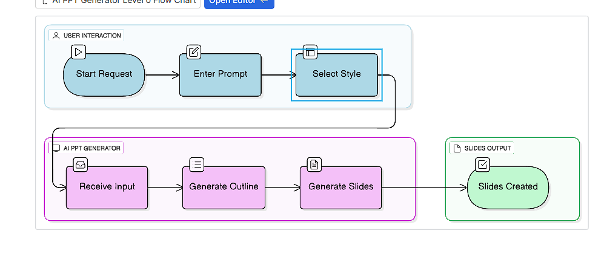



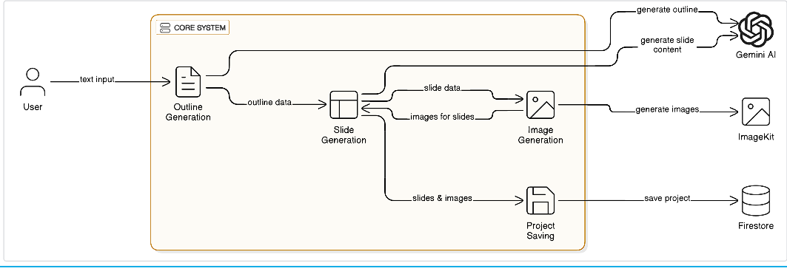

System Architecture Overview
User Input
Topic entry via React interface
AI Processing
Gemini generates outline and content
Visual Creation
ImageKit produces relevant images
Cloud Storage
Firestore saves complete project

Slide 7
Complete Workflow Process
Topic Submission
1
User enters presentation topic through intuitive interface
2
AI Outline Generation
Gemini AI analyzes topic and creates structured outline with slide breakdown
User Review & Refinement
3
User reviews and edits outline before proceeding to full generation
4
Content Generation
System generates complete slide content with formatting and structure
Image Creation
5
ImageKit automatically generates contextually relevant visuals for each slide
6
Final Editing & Export
User makes final adjustments using real-time editor, then saves to cloud

Slide 8
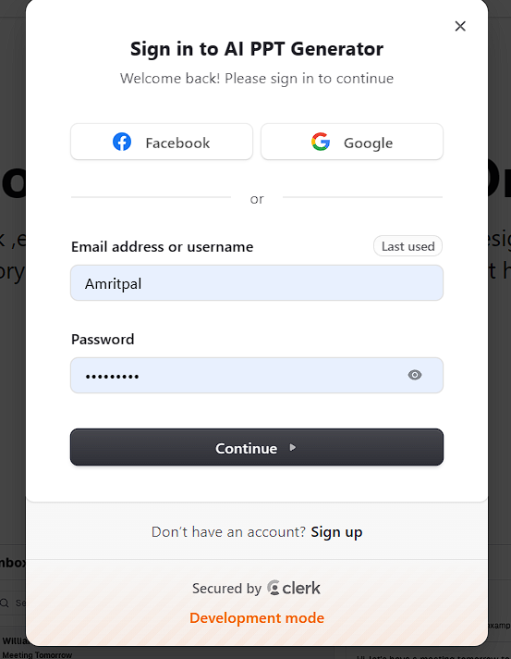
Authentication & Security Layer
Powered by Clerk
Secure Authentication: Enterprise-grade login system protecting user data and projects
Session Management: Seamless user experience across multiple devices and sessions
Subscription Control: Role-based access ensuring only authenticated users can save and manage projects
User Privacy: Complete data protection with encrypted storage

Slide 9
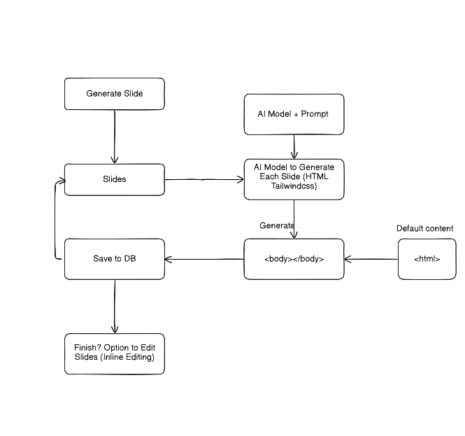
AI-Powered Content Generation
1
Outline Creation
Gemini AI analyzes the topic and generates a logical, structured outline determining optimal slide count and flow.
2
Content Development
Each outline point is transformed into full slide content with professional titles, concise bullet points, and detailed explanations.
3
Consistency Assurance
AI maintains uniform tone, formatting, and presentation-friendly language throughout all generated content.

Slide 10
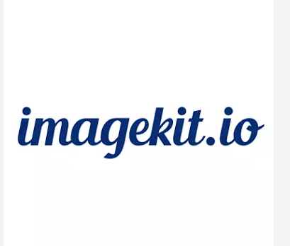
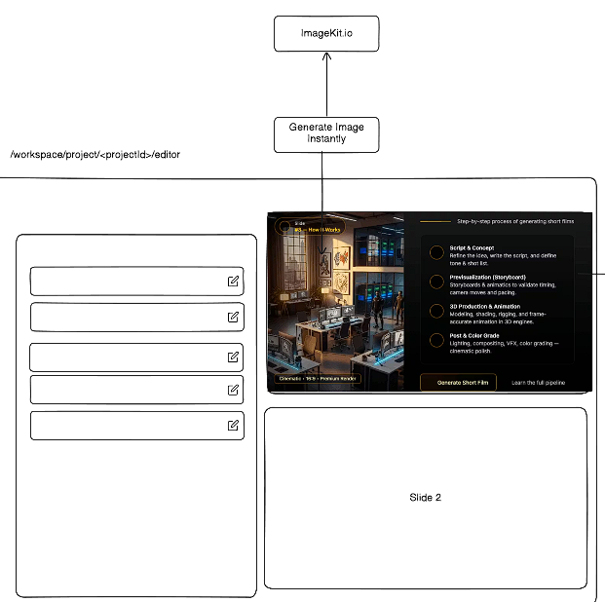
AI-Powered Image Generation
ImageKit automatically generates contextually relevant images that bring your slides to life. By analyzing slide content, it creates visuals that enhance your message and stores them securely in Firestore for instant access.
Smart Creation
Analyzes slide text to generate perfectly matched images
Cloud Storage
Securely stores all image URLs in Firestore database
Auto-Insertion
Seamlessly integrates images into your slides automatically
Flexible Regeneration
Don't like the result? Regenerate instantly with one click

Slide 11
Firestore: The Backbone of Our System
What We Store
Key Benefits
User Projects
Complete presentation data and settings
Lightning-Fast Sync
Cloud infrastructure ensures instant data synchronization across all devices and sessions
Content Outlines
Structured frameworks and hierarchies
Slide Content
Real-Time Updates
All text, formatting, and layouts
Changes propagate immediately, enabling seamless collaboration and live editing
Image URLs
References to all generated visuals
Infinite Scalability
Handles massive datasets effortlessly as your user base and content library grows
Metadata
Timestamps, user IDs, and version history

Slide 12


Transforming Workflows Across Industries
Students
Educators
Business Professionals
Researchers
Create compelling presentations for assignments, seminars, and research projects with professional polish in minutes
Prepare engaging lecture materials and educational content quickly, spending more time teaching and less time designing
Craft persuasive pitch decks, quarterly reports, and client presentations that command attention and drive results
Transform complex findings into clear, visually appealing summary presentations for conferences and publications
Content Creators
Generate slide decks rapidly for social media, video content, and online courses without sacrificing quality

Slide 13

The Future of Presentation Creation
AI-Driven Automation
Time & Effort Savings
Our system handles the entire presentation workflow—from outline generation to image creation—freeing you to focus on your message
What once took hours now takes minutes, with consistent, professional results every time
Perfect for Everyone
Whether you're new to design or short on time, our platform ensures high-quality output that looks professionally crafted. No design skills or writing expertise required—just bring your ideas.
What's Next?
Direct PowerPoint Export: Download finished presentations in native PPTX format
Real-Time Collaboration: Work together with teams seamlessly
Template Library: Access curated designs for every industry and occasion
Advanced Customization: Fine-tune branding, colors, and styles

